Slide 1

Crime in the City
A study of SF Police Reports in San Francisco

Slide 2

Introduction
The City of San Francisco wants to understand the nature of crime across the city
Research Questions:
Where crime is happening?
When it is happening?
What we can do to make the city safer?

Slide 3
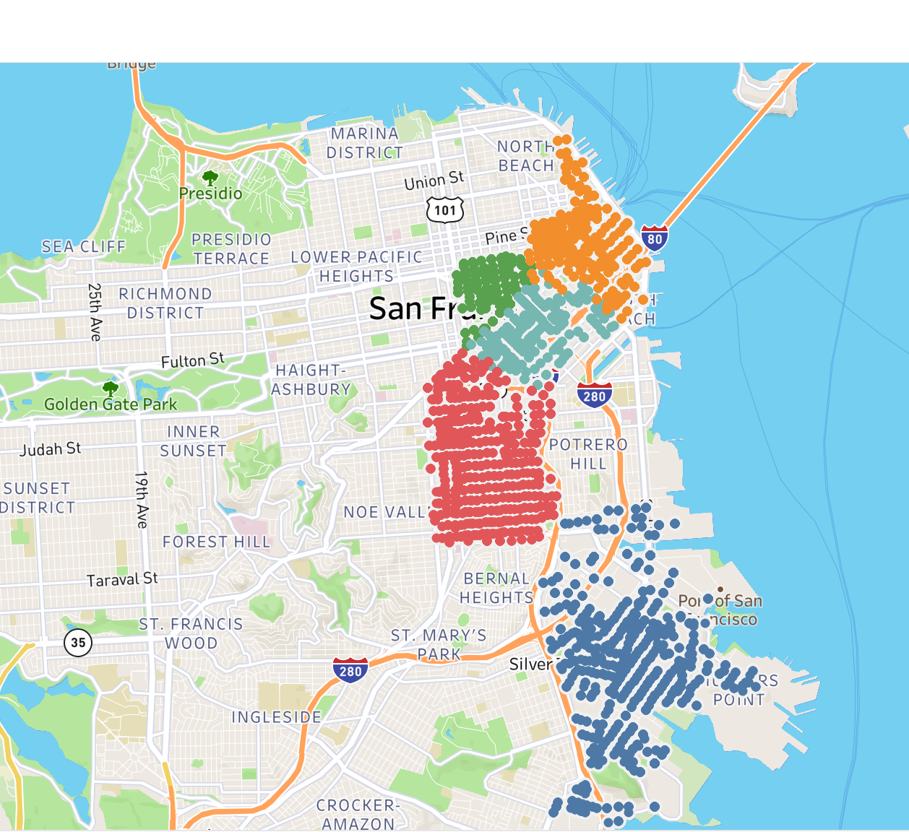
Methodology
Dataset includes:
Police reports from 2018-2021 (YTD): 65,356 reports
Mental Health Incidents in 2018: 3,893 reports
Data Analysis via Excel
Data Visuals via Excel and Tableau
Focused on five neighborhoods:
The Financial District (FiDi)
The Tenderloin
South of Market (SoMa)
The Mission
Hunter’s Point
FiDi
Tenderloin
SoMa
Mission
Hunter’s Point
Note: Each dot on the map represents an individual police report this year

Slide 4
Five Neighborhoods represent 44% of the Police Reports
Each neighborhood has its own unique fingerprint
Days when an incident happens
Hours when incident happens
Types of offences
Hunters Point has seen an increase over this time period (2018-2021).
The other four neighborhoods saw consistently higher police reports than the rest of the city.

Slide 5
A week in the Life
The Mission
The Other four
Mission peaks on Friday
Plateaus during the weekend
Greater percentage of overall reports on the weekend
See increases during the week
See decreases on weekend
Bayview Hunters: -21%
Tenderloin:-20%
Financial District:-18%
South of Market: -18%

Slide 6
A Day In the Life
Day
Police reports spike in early hours of day
The Tenderloin has the highest number of reports until mid-day
Police reports in the Mission stay high deeper into the night

Slide 7
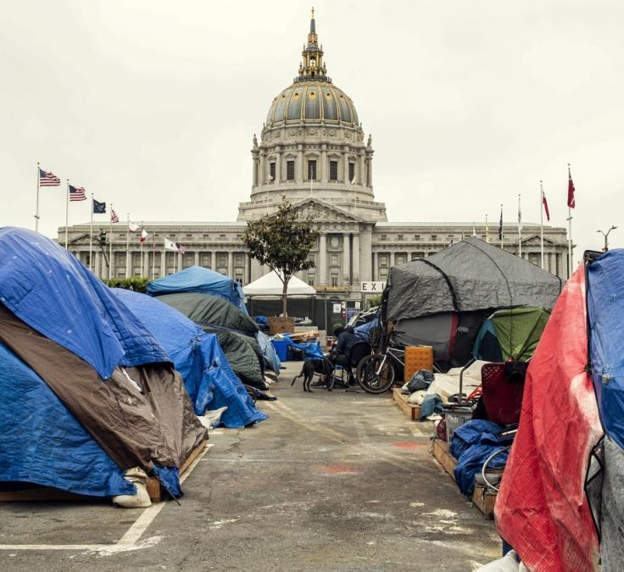
“Other Miscellaneous”: Crime, Homelessness and Mental Health
8,035 homeless on the streets of San Francisco¹
41% suffered from drug or alcohol abuse²
39% reported psychiatric or emotional conditions³
Often end up unclassified in police reports
1.) Source: https://sfgov.org/scorecards/safety-net/homeless-population 2019 Point-In-Time count
2.) Source: 2017 City of San Francisco Point-In-Time Count
3.) Source: 2017 City of San Francisco Point-In-Time Count

Slide 8
While the city has not always categorized Mental Health Incidents, they did keep a dataset in 2018
High correlation between neighborhoods with more mental health incidents and neighborhoods with more police reports.
R^{2:}: 84%

Slide 9

Types of Reports Not Uniformly Distributed: Drugs in The Tenderloin
If you’ve ever traveled through the 224 acres of the Tenderloin, you’d know there are drug problems in the area.
While it is only 0.7% of the total city acreage, it represents 60% of the cities drug offences

Slide 10

Recommendations for the City
Recommendations:
Build out larger dataset classifying mental health problems.
Deploy an additional social services team to specifically address mental health issue
Target police in certain neighborhoods/areas at certain specific hours
Determine if social services team reduces overall criminal incidence
Determine if change in deployment of officers reduces criminal incidence.
Challenges:
Potential bias built into data as it is built upon individual report/classification

Slide 11
Recommendations for the City
Conclusions:
There is a distinct pattern to police reports in the city (neighborhoods, days, times and types)
Mental Health and Homeless are an integral part of the challenge.
One note of caution: This data is based on police reports, which could be a source of potential bias.
Recommendations:
Build out larger dataset classifying mental health problems.

